Slide 1

Version 1.0
MakerDAO: The Future of Decentralized Finance
function isAuthorized(address src, bytes4 sig) internal view returns (bool) {if (src == address(this)) { return true;} else if (src == owner) {retu

Slide 2
Contents
About MakerDAO
MKR Token
Introducing Dai
Collateralized Debt Positions (CDPs)

Slide 3

Version 1.0
About MakerDAO
Headquartered in Copenhagen, Denmark MakerDAO (Maker for short) is a rapidly growing fintech company with over 75 employees and offices in seven cities across four continents. Maker has blockchain technology in its DNA. Being the first organization to launch a working product on the ethereum blockchain, the first to deploy a fully decentralized exchange, and the first to formally verify in-production smart contracts - all in three years- Maker is no stranger to being a first mover and industry leader.

Slide 4
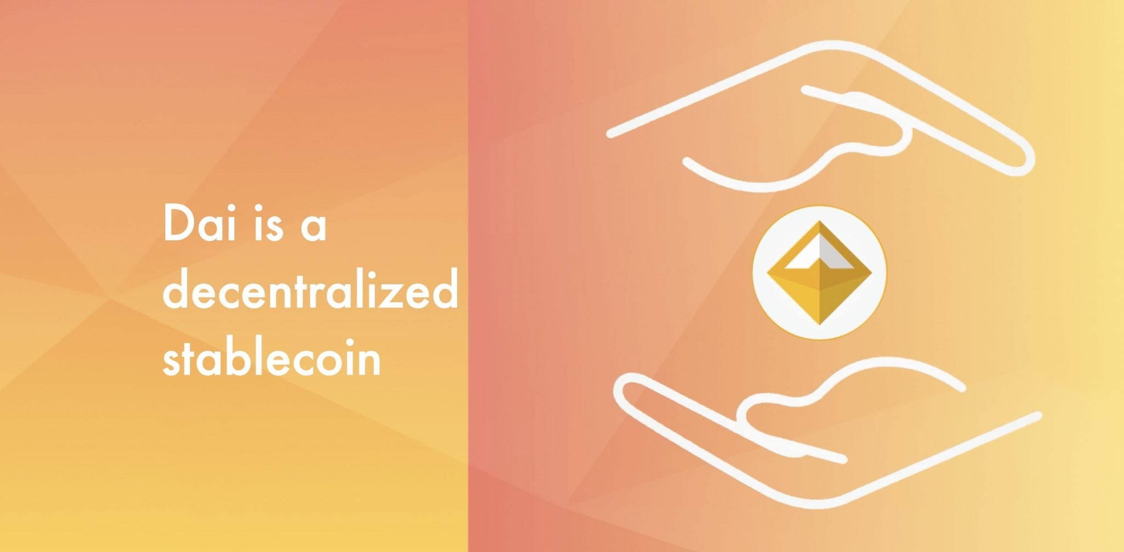
Version 1.0

Slide 5

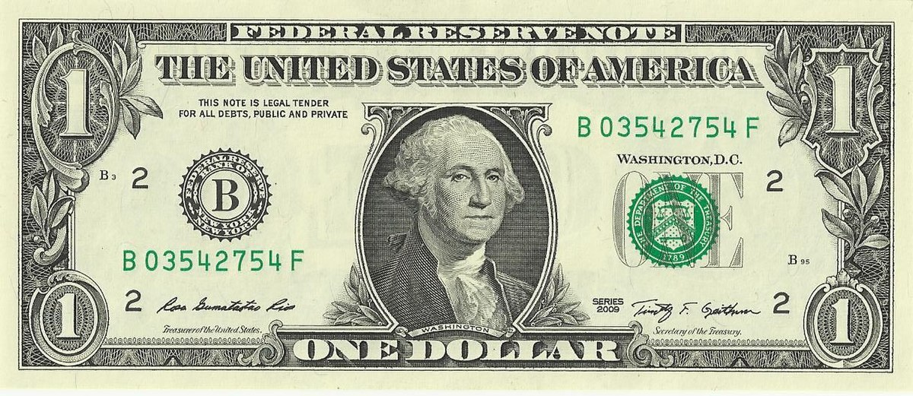
Version 1.0
Meet Dai
Dai is the world’s first decentralized stablecoin. A stablecoin is a cryptocurrency with price stability relative to an existing currency or a basket of currencies. Dai is pegged to the US Dollar. We say it’s decentralized because it exists on a public blockchain and can be created, stored, transferred, and destroyed without the assistance of a financial intermediary.
1 Dai = $1

Slide 6
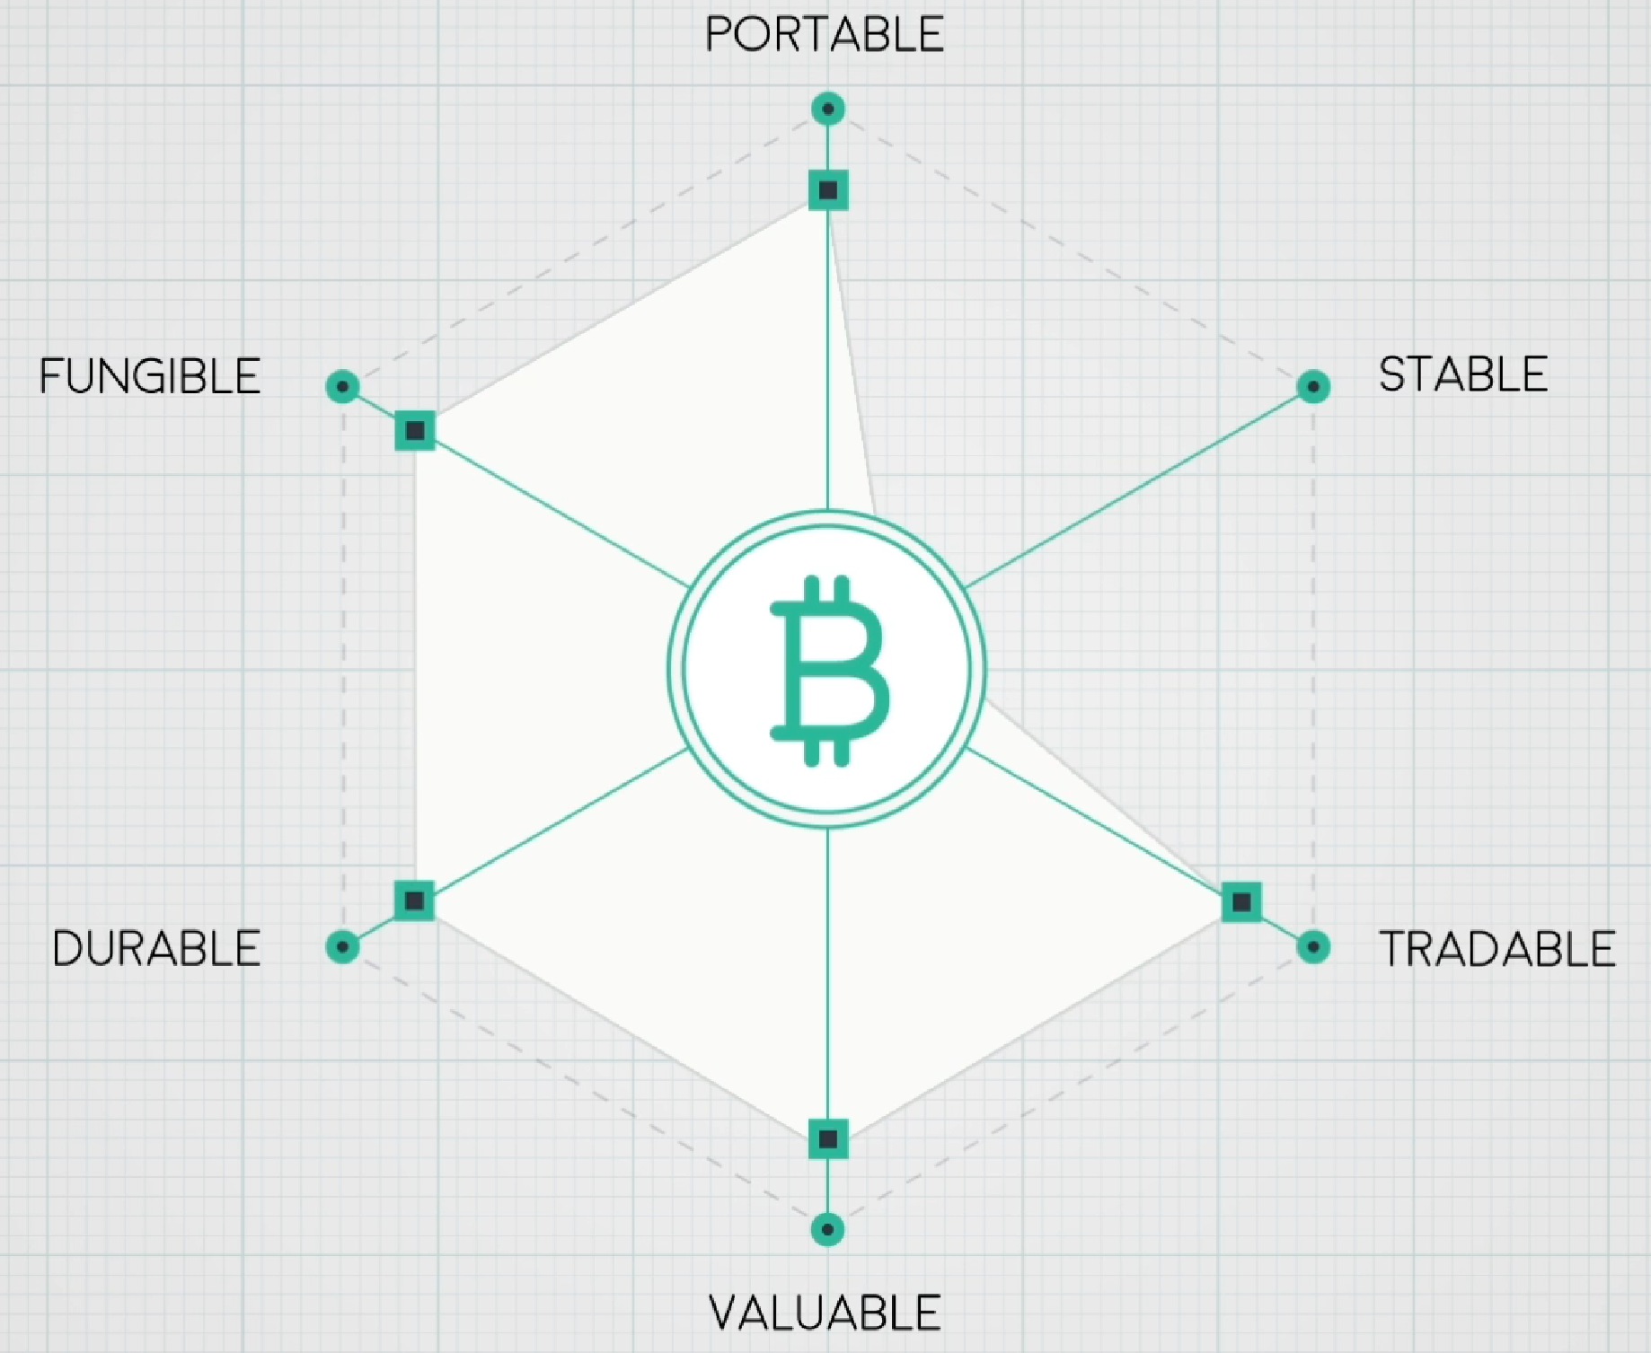
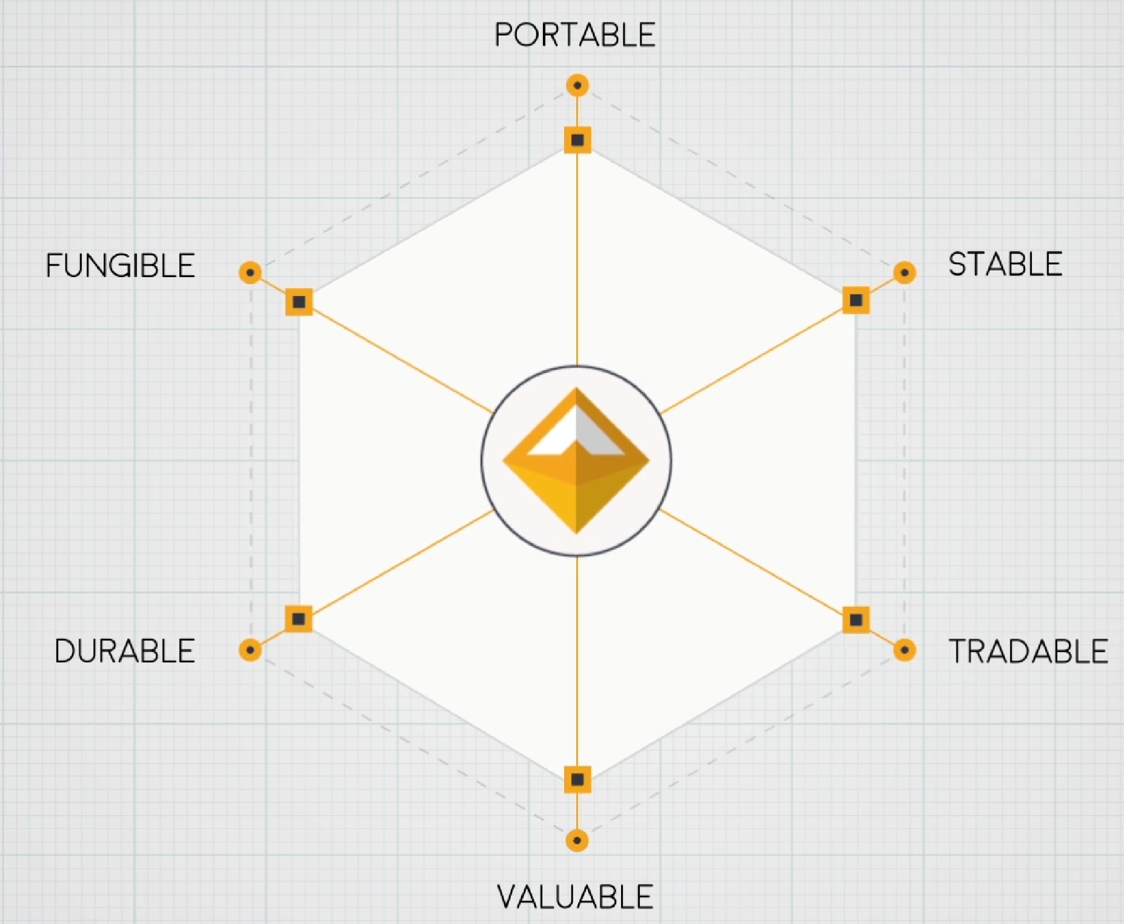
Version 1.0
Traditional Cryptocurrency
Dai
Traditional cryptocurrency was designed to be a better form of peer-to-peer cash. Unfortunately, it lacks stability and falls short of this goal.
Dai solves the stability issue while retaining the decentralized nature of cryptocurrency. Dai is truly better peer-to-peer cash.

Slide 7
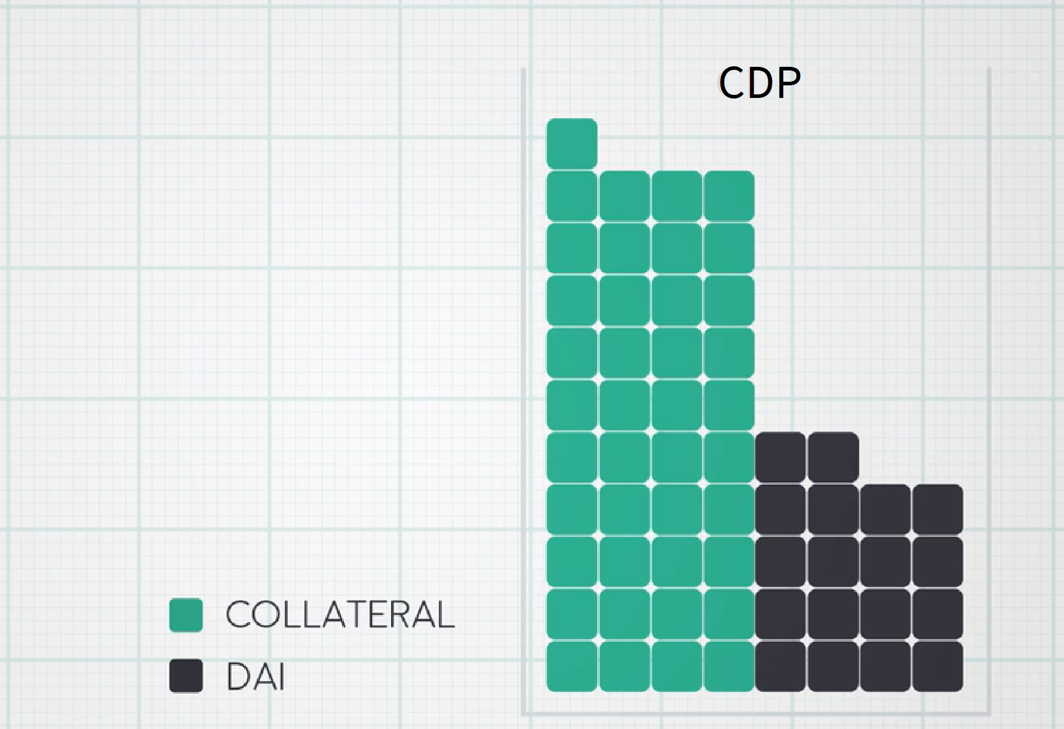
Version 1.0
Collateralized Debt Positions (CDPs) are Decentralized Secured Lending

Slide 8
Version 1.0
What are CDPs?
Collateralized Debt Positions are at the core of the Dai Credit System - these contracts are responsible for creating and maintaining the supply of Dai.
Traditional lending institutions borrow short and lend long, this puts a floor on the interest rate they can charge. Often, even on well understood secured loans, a borrower will end up paying a rate far outside of the risk profile of the asset they are borrowing against. The Dai Credit System issues loans strictly against the risk profile of the asset deposited as collateral, never playing favorites. Additionally, because our system effectively creates the money being lent, it can lend at an unmanipulated natural rate of interest.

Slide 9
Version 1.0
Breaking Down a CDP
CDPs are smart contracts (software that runs on a blockchain), this means they follow strict programming rules. The source code can be broken down into six steps:
Accept user’s pledged collateral
Check parameters for lending against this specific collateral
Create a Dai facility against the collateral
Given the loan is paid back in full with interest, release the collateral and send part of the interest payment to MKR holders by burning MKR tokens. — — — — — — — — — — — — — — — —
If the loan goes below a certain threshold, liquidate the collateral for Dai up to the value of the loan — destroy this Dai
In the event of a liquidation, if there is not enough collateral to cover the value of the loan in Dai, dilute MKR token holders by printing MKR tokens and selling it for Dai until there is enough to offset the loan

Slide 10
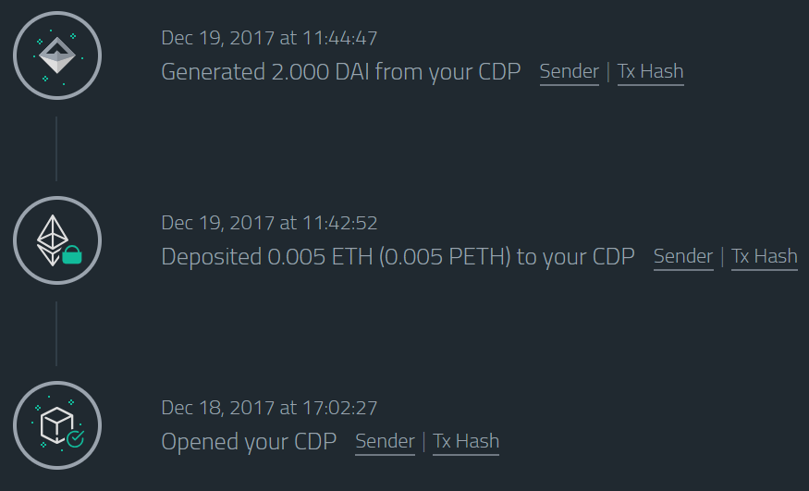
Version 1.0
Example: Repaid Loan
Assumes a minimum 150% collateralization ratio and a 1% stability fee
Deposit a security token worth $1000 into a CDP smart contract.
Borrow 500 Dai (50% LTV or 200% collateralized). 500 Dai created.
Hold loan for one year and pay back 505 Dai (1% APY). 500 Dai destroyed Liquidate 5 Dai for MKR tokens and burn them
Withdraw security token.

Slide 11
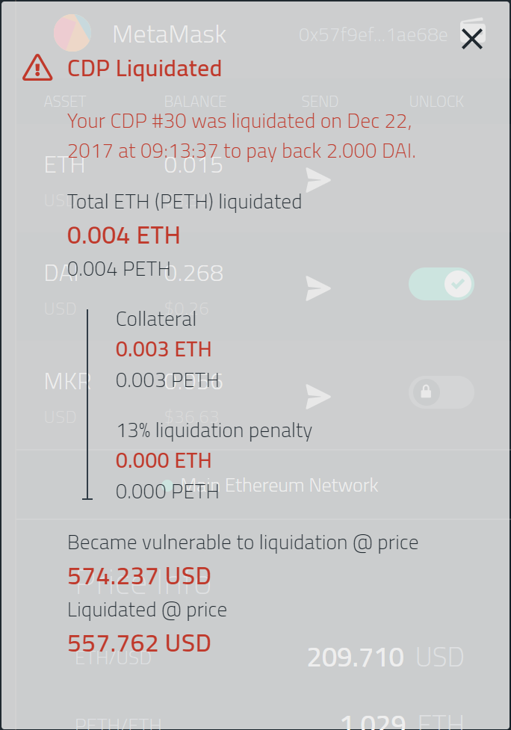
Version 1.0
Example: Liquidated Position
Assumes a minimum 150% collateralization ratio and a 1% stability fee
Deposit a security token worth $1000 into a CDP smart contract.
Borrow 500 Dai (50% LTV or 200% collateralized). 500 Dai created.
If the value of the security token goes below $750 (<150% collateralization ratio), liquidate enough of the asset to raise 500 Dai.
Return excess to borrower.
If the liquidation results in less than 500 Dai raised, print sufficient MKR and sell it until there is a total of 500 Dai available. 500 Dai destroyed

Slide 12
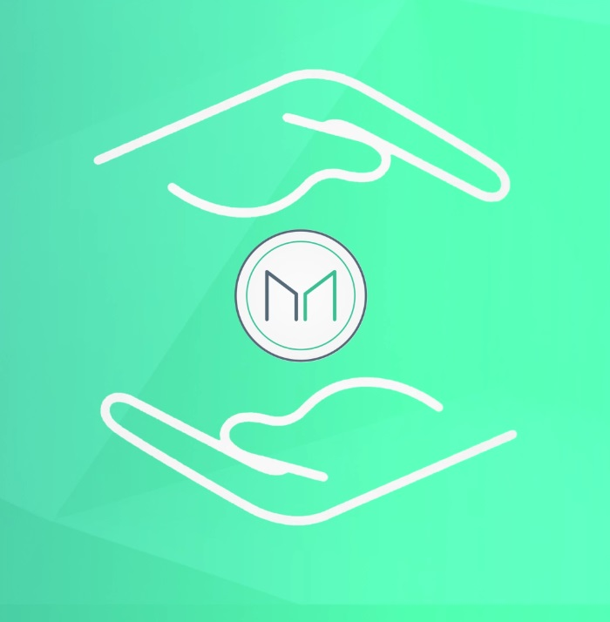
Version 1.0
MKR Governors Underwrite Loans
Maker (MKR), a blockchain token that has traded liquidly on cryptocurrency exchanges for approximately three years, is both the governing body and underwriter of all loans in the Dai Credit System. MKR holders must vote on the parameters by which loans are issued; namely the collateralization ratio, debt ceiling, and stability fee.
When the loan portfolio performs well, MKR holders collect the aggregate interest rate in the system. In the edge-case of a collateral shortage, MKR holders are diluted to protect Dai’s stability.

Slide 13
Version 1.0
MakerDAO: The Future of Decentralized Finance
function isAuthorized(address src, bytes4 sig) internal view returns (bool) {if (src == address(this)) { return true;} else if (src == owner) {retu

